Slide 1



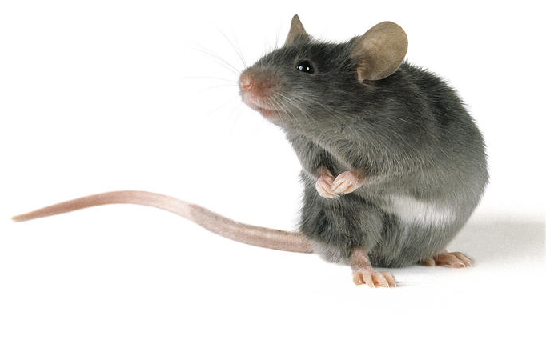
# 2019 KSMCB
Development of a Low-cost, Comprehensive Recording System for Circadian Rhythm Behavior
Jea Kwon
Ph.D. candidate
@ Lab of C. Justin. Lee

Slide 2
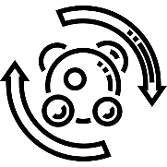

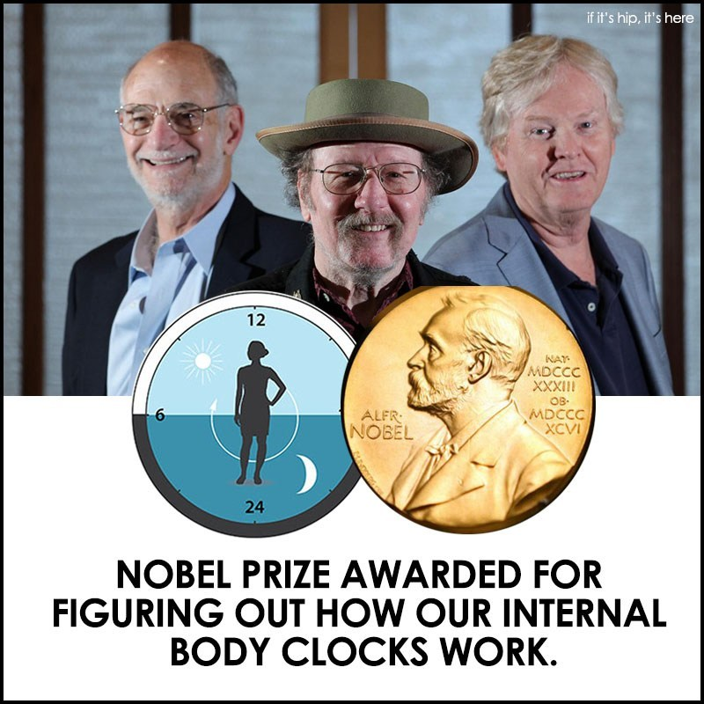

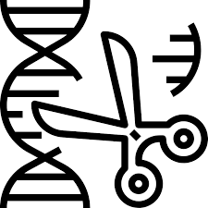


2017 Nobel Prize in Circadian Rhythm Field
Metabolism
Medicine
Immunology
Genome Edit
Microbiome
Computation
Gained a lot of Interests from various research field.

Slide 3
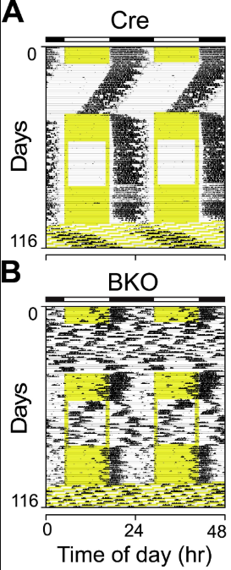
To study in-vivo function of circadian rhythm in animals
Control Group
Experimental Group
Actogram
Modified image from Izumo et al. eLife (2014)
Actograms made of wheel running behavior is what we need

Slide 4
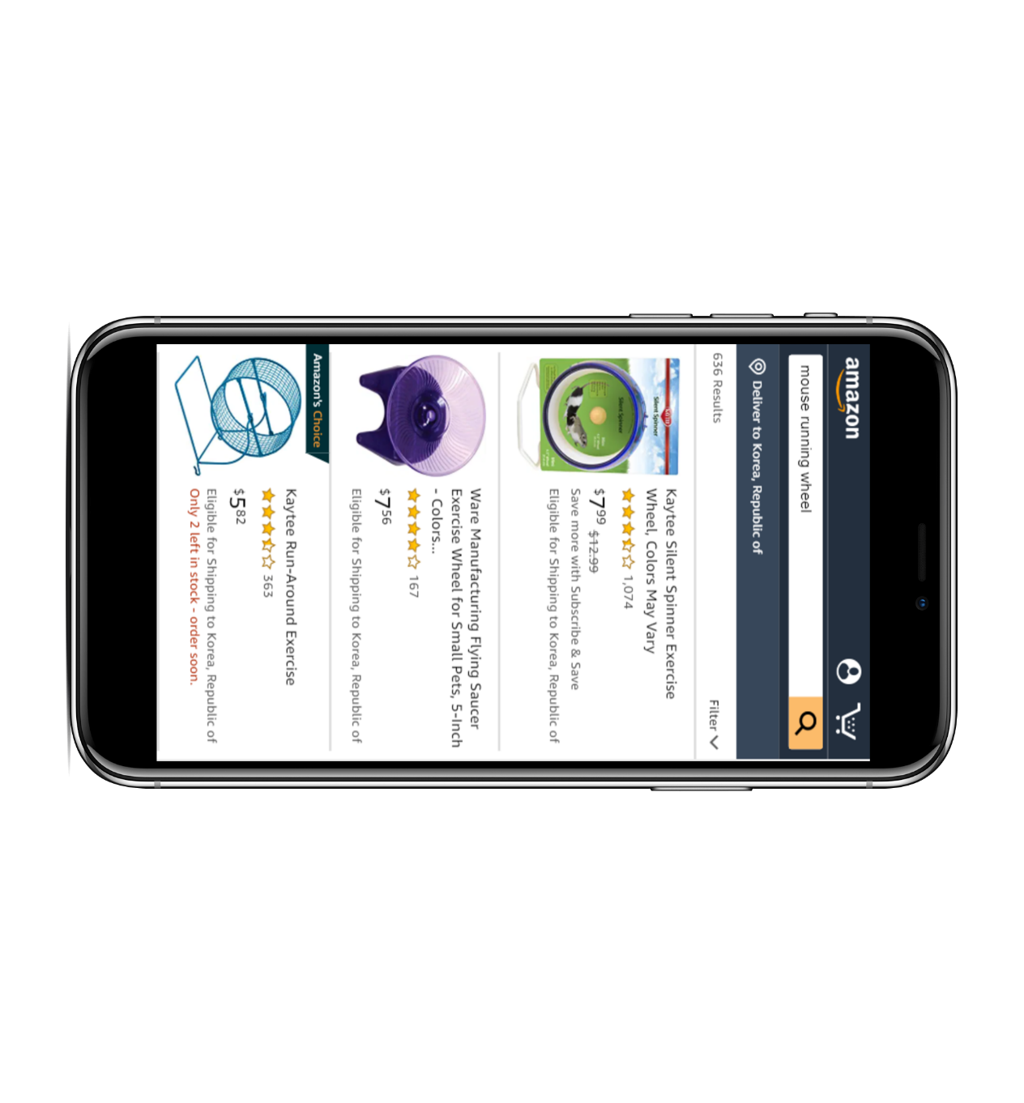
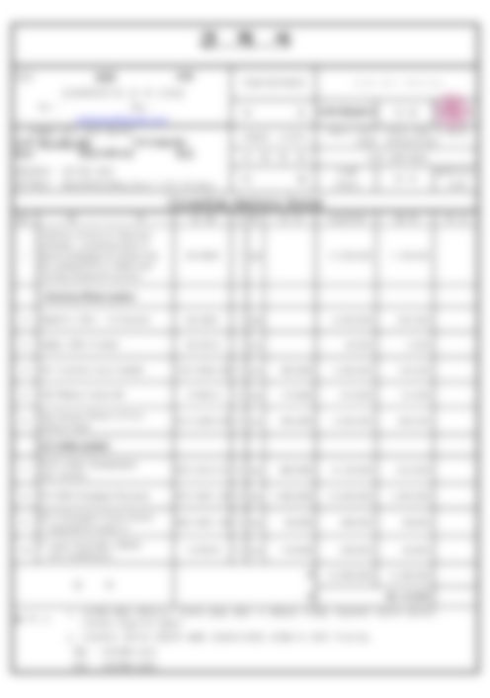

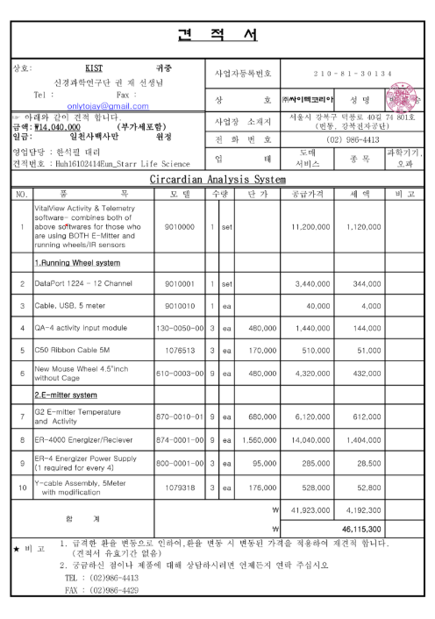


Yes, I am the one who wanted to get those actogram data…
Less than $ 1,000
for 9ea
More than $ 40,000
for 9ea
!?
…
Expectation
Real Price

Slide 5
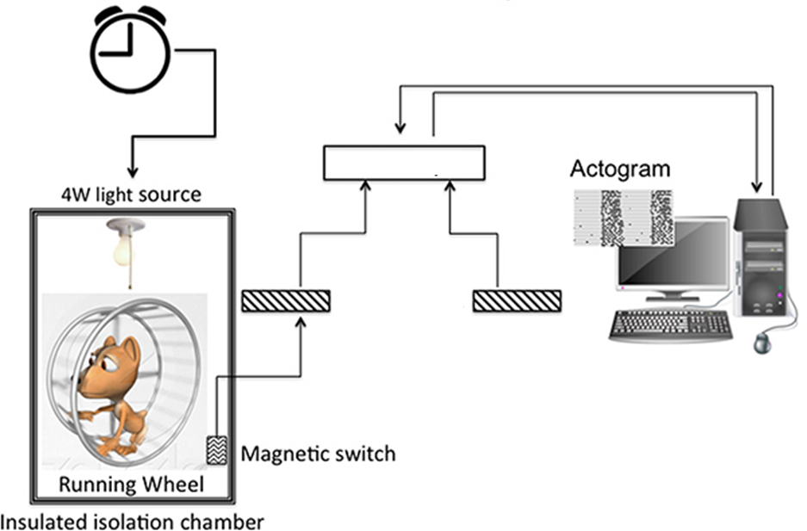
The reason for high cost is…
Customized Wheel
Wheel compatible Magnetic Sensor
Wheel compatible Animal Cage
Hardware/Software compatible A/D Converter
Hardware compatible Software
AD converter
Wheel-Running System is provided as package
Customization is the main reason of
High cost in wheel running system

Slide 6
That’s why we did…

Slide 7
# Research Title
Development of a Low-cost, Comprehensive Recording System for Circadian Rhythm Behavior

Slide 8
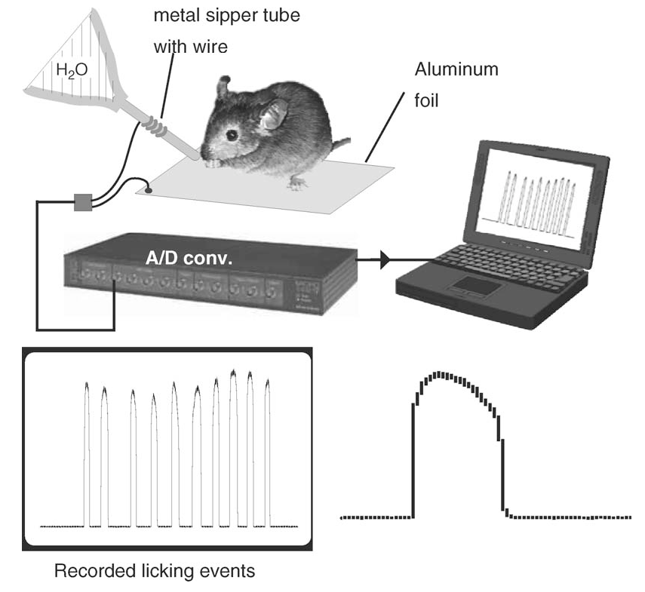
Inspirational previous study
Licking Behavior Recording
Hayer and Bryant. J. Neurosci Methods (2006)
Junction potential change measured by A/D converter

Slide 9
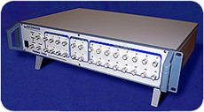
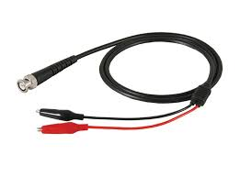
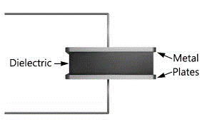
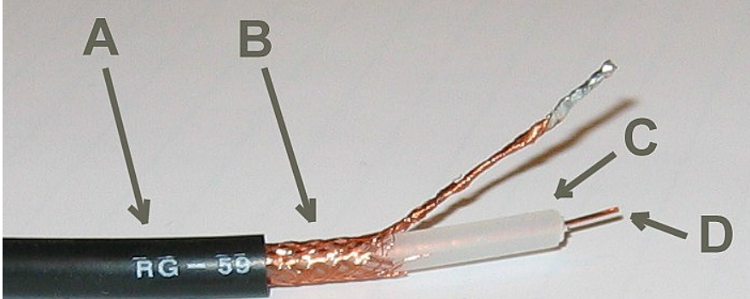
Concept of System: How it works?
BNC core
D
BNC shell
B
Change of dielectric object between metals generates electrical signal

Slide 10
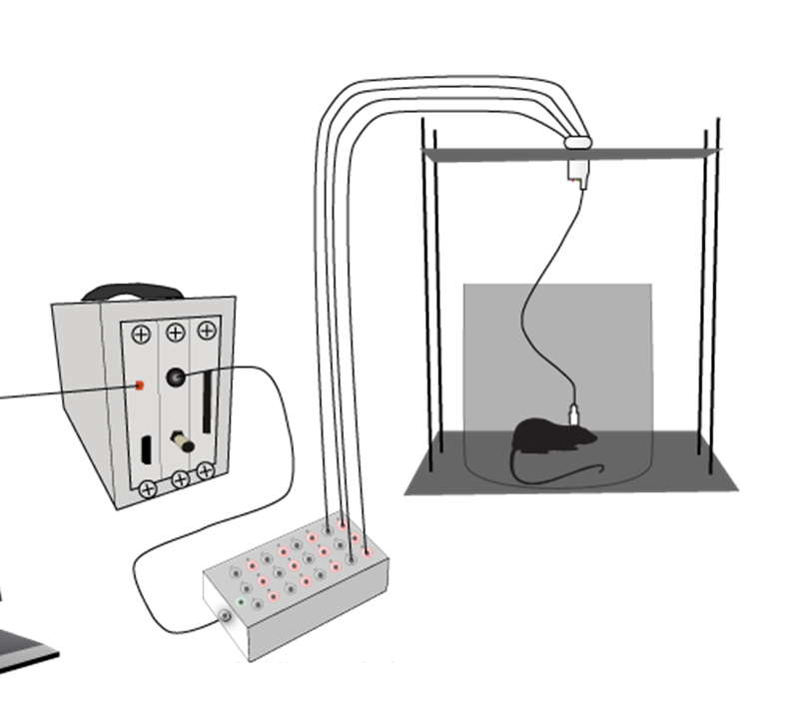
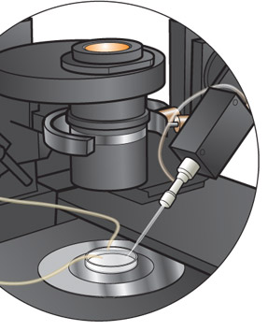

Benefits of System: Why electrical signals?
EEG Recording
Patch Clamping
Electrical Signals are
Fast, Accurate, Stable

Slide 11
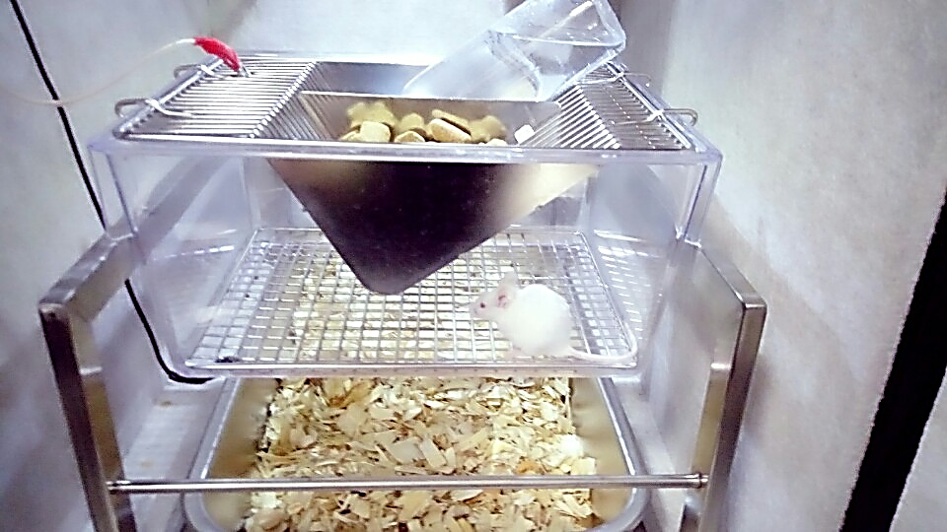
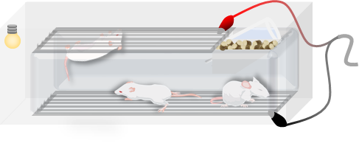
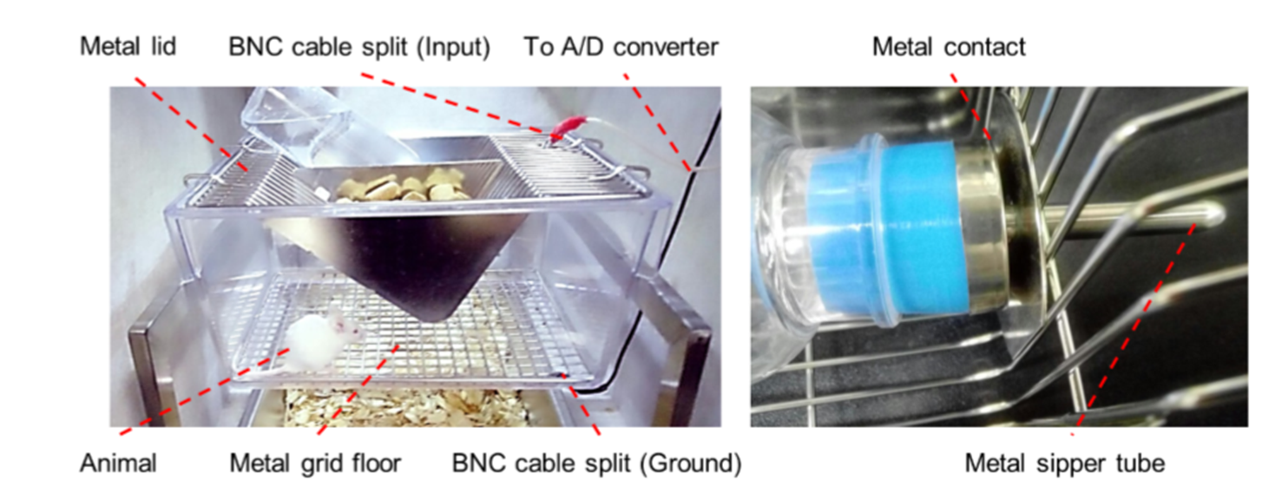
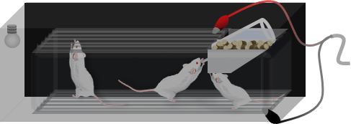
Experimental design of House-Keeping Activities(HKA) recording system.
BNC core connected
with Metal Lid
No Contact
Hanging
Crawling
Sleeping
Metal
contact
Animal
BNC core connected
with Metal Floor
Grabbing
Drinking
Eating
Contact
Electrical signals generated by Grabbing, Drinking and Eating

Slide 12
Data Processing: Towards to actogram
1. Raw data
4. Resampled
2. Filtered
5. Auto Threshold
3. Absolute
6. Activity Counts
Automation
Algorithm for HKA

Slide 13
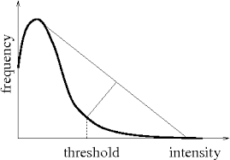
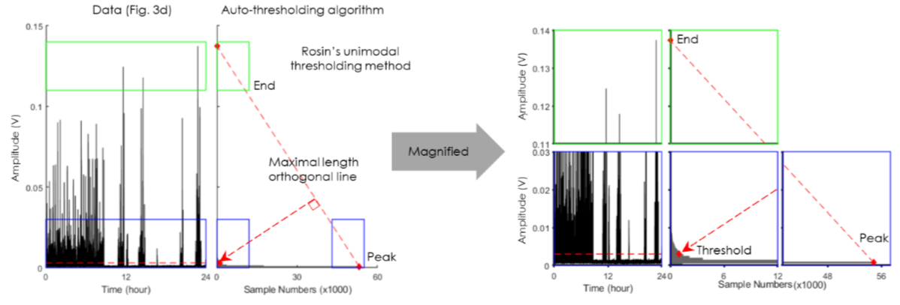
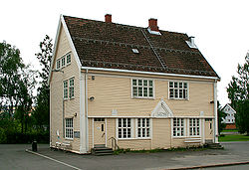
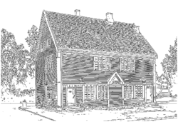
How to automatically distinguish contact signals from baseline?
Rosin’s Unimodal Thresholding
Original
Rosin’s Algo.
Rosin’s algorithm powerfully dissociates contact activity from baseline

Slide 14
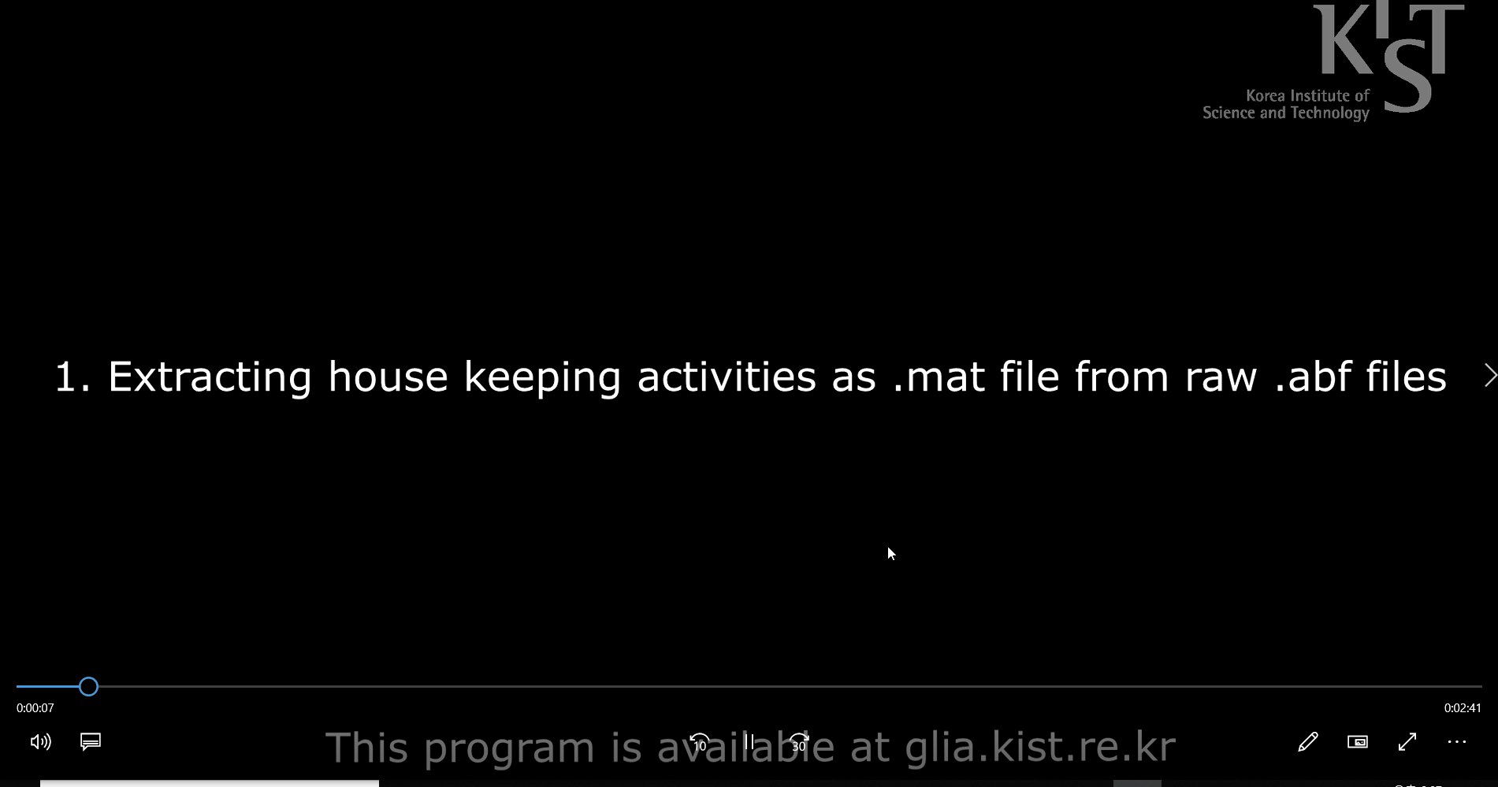
Demonstrations of Circa Analysis Program

Slide 15
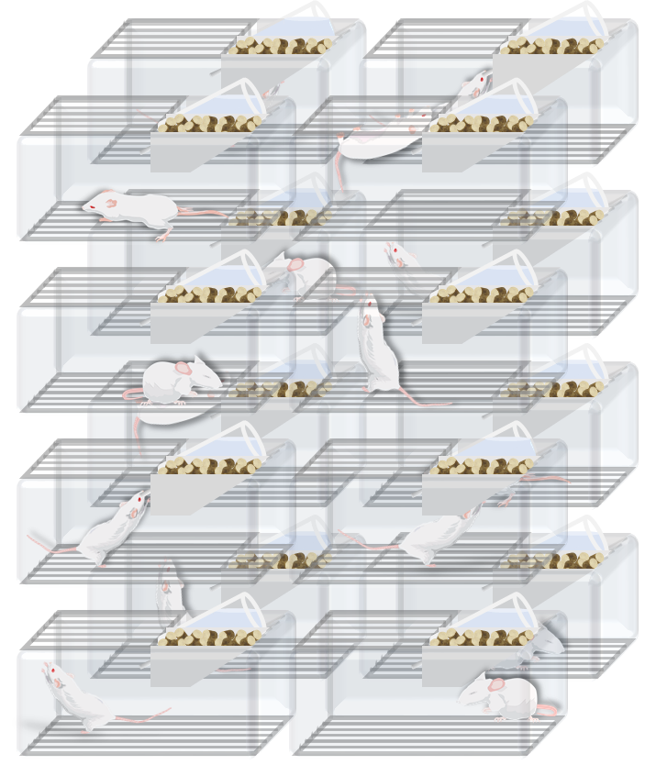
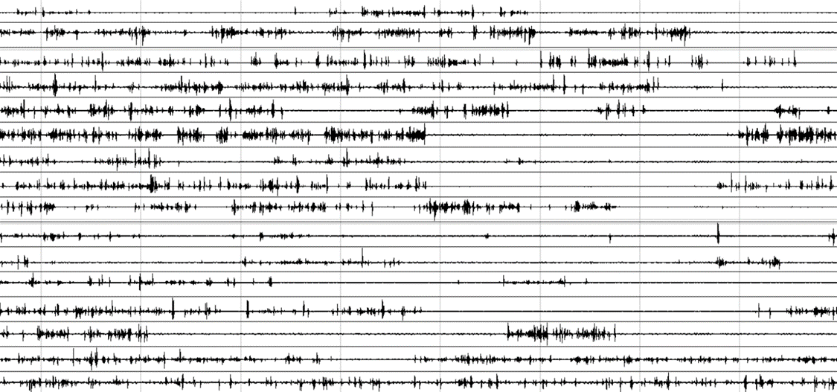
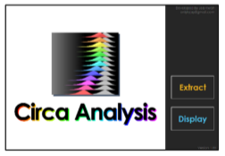
Comprehensive system for Circadian Rhythm recording
16 Channel
Standard
Digitizer
Data
Acquisition
16 Cages
16 channel simultaneous recording of circadian rhythm

Slide 16
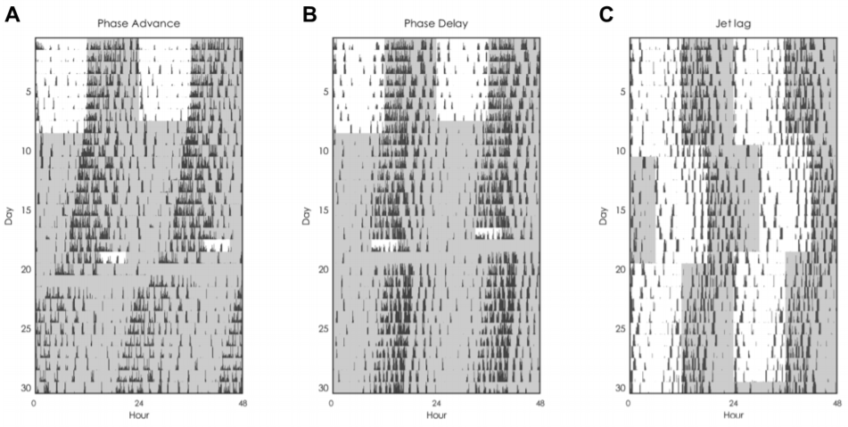
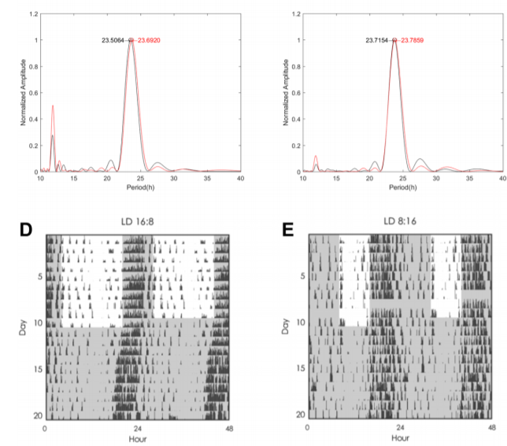
Example Actograms of 180-days continuous recording with various protocols
Actograms made of Circa Analysis v1.00

Slide 17
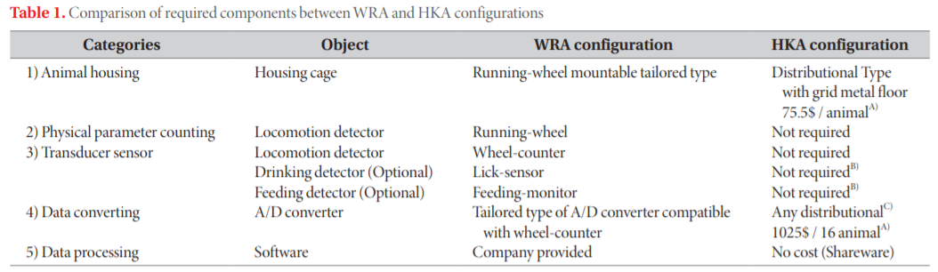
Comparison between WRA and HKA configuration
150$/channel
HKA system as a low cost solution for circadian rhythm recording

Slide 18
Summary of HKA system
PROS
CONS
Low cost: No sensors. Commercially available cheap cage.
Activity separation: Isolation of metal object can separate various activities.
Easy maintenance: Easy Animal housing. Stable recording by simple configuration.
Animal welfare: No Beddings, No isolated ventilation
Wire-attached experiments N/A: Optogenetics, Microdialysis, etc.
Specific A/D converter required: HKA systems made upon Digidata, provided for electrophysiology

Slide 19
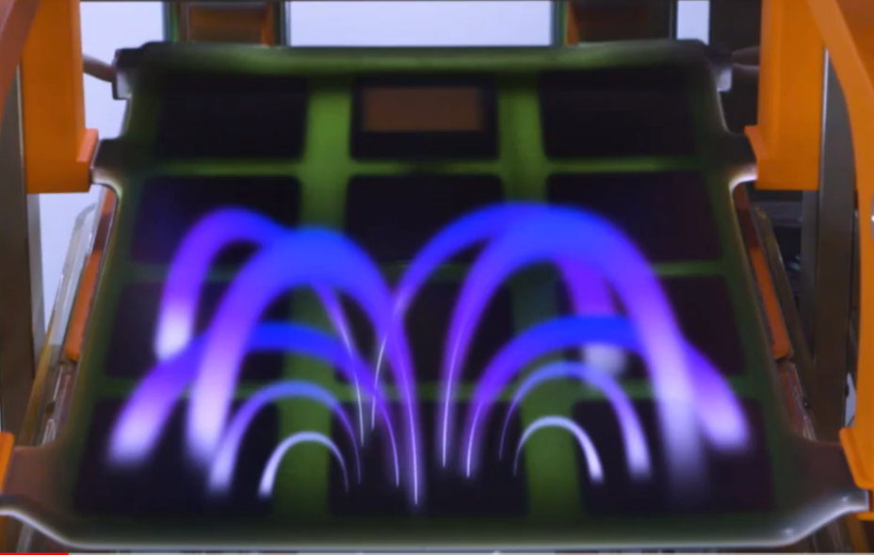
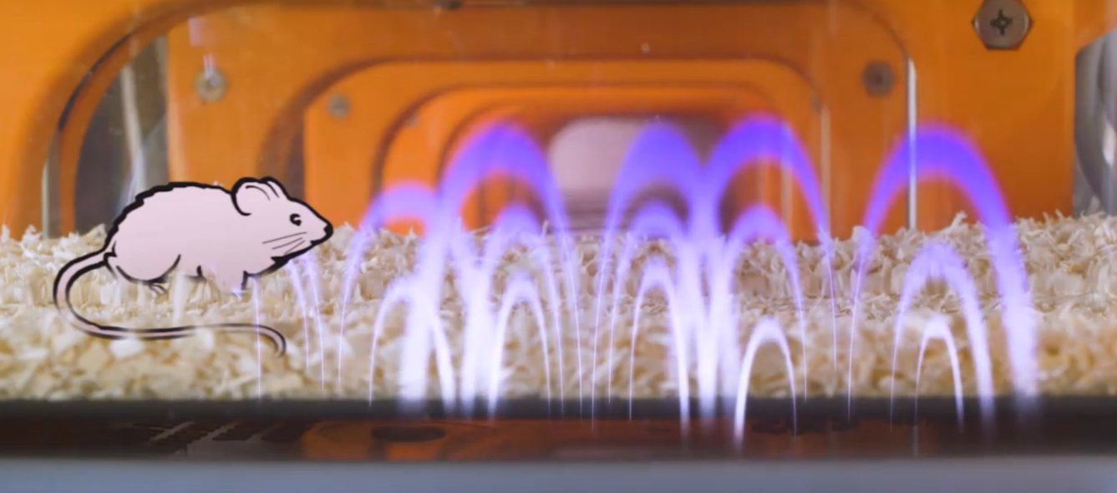
What is next generation for circadian rhythm recording?
Remote monitoring of
magnetic field change
https://www.youtube.com/watch?v=CZ6R63pXKSQ

Slide 20
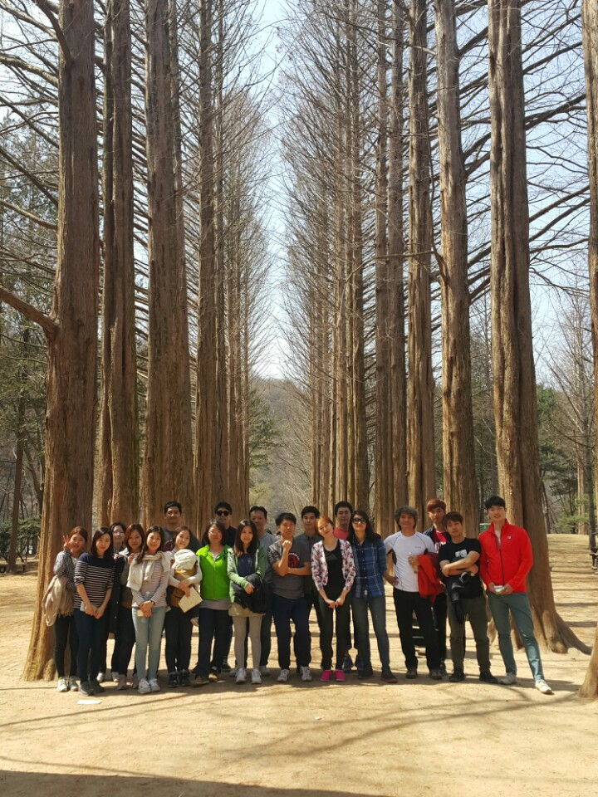
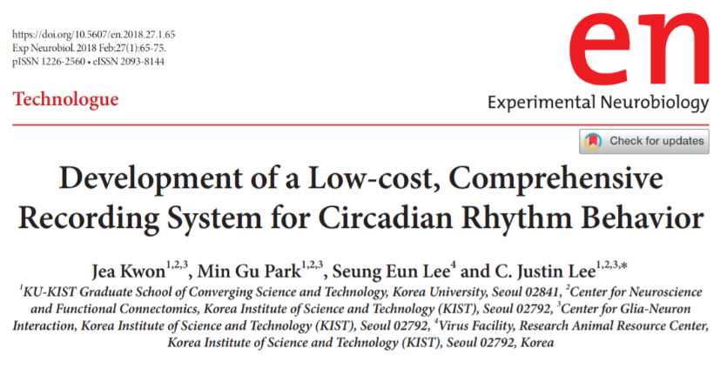

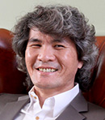

Jea Kwon
C. Justin. Lee.
Seung Eun Lee
Min Gu Park
Center for Cognition and Sociality (Cognitive Glioscience Group) at IBS

